Slide 1

London Housing
Submitted by
Tresa Varghese

Slide 2
Introduction
A case study on housing price change in the 32 boroughs in London over the 2 decades available in the dataset.
The analysis focuses on finding the boroughs that have seen the greatest increase in price. This helps in identifying the boroughs that are most desirable to live in.

Slide 3
Findings
Among the 32 boroughs in London, the Hackney borough has seen the greatest increase in housing price in 2018, when compared to the price in 1998.
The Waltham Forest borough is the second most expensive borough based on available data.
If we look at the top 15 boroughs with highest pricing increase, the increase in other 13 boroughs is almost neck to neck.

Slide 4
Reasoning behind findings
Data Source : The London Datastore
Cleaning and transformations performed:
Transpose rows and columns, reset index
Melt columns representing individual months to a single column and extract year information.
Group rows by year
Drop null values as the rows doesn’t include any useful information
Remove observations that doesn’t represent an actual London Borough

Slide 5
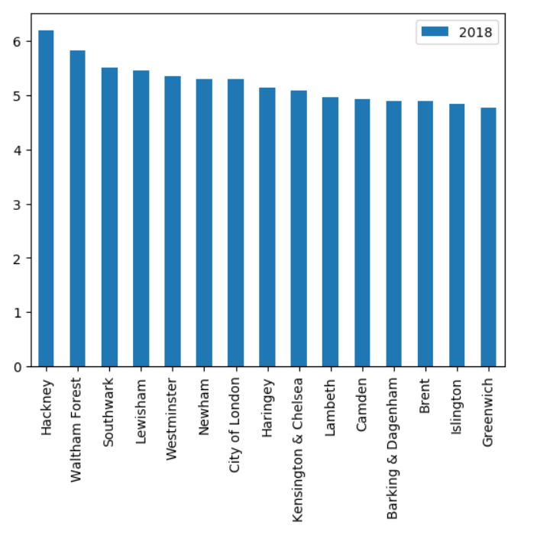
Reasoning behind findings
Cleaned data is grouped by borough name and year and average price is computed for each group.
For each borough, the ratio of 2018 price to 1998 price is calculated.
Resulting data is sorted in descending order of ratios to find the top 15 boroughs with highest pricing increase.
A bar graph is drawn based on the resulting data to visualize the pricing increase over the two decades

Slide 6
Challenges encountered
The original data had observations along the columns and features along the rows. Transpose operation was performed on the data frame to convert rows to columns and vice versa.
The original data included over 300 columns that correspond to timestamp representing different months. It was converted into a single column using melt feature. Then, year information is extracted from the timestamp and the resulting rows are grouped by year to find the average price for each year.
The original data included null values and rows that doesn’t represent an actual London borough. These rows are identified and removed before making the final model

